Slide 1

Feature Extraction of EEG Signal on FPGA
Course no : ECE 4000
Course title :Project and thesis
Date : 25 February,2020
Supervised By- Presented by-
Dr. Sheikh Md. Rabiul Islam Progga Labani Howlader
Professor, Dept of ECE,KUET Roll:1509035

Slide 2
Overview
Introduction
Goal of the work
Concept of EEG signal
Filtering
Feature extraction
Vivado Xilinx Software
FPGA
Methodology
Experimental observation
Result Analysis
Conclusion
Future work

Slide 3
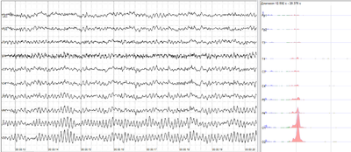
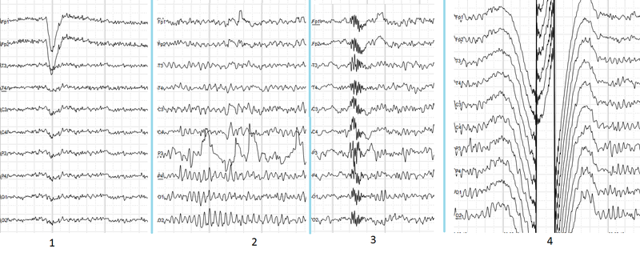
Introduction(1/2)
Figure 1: Normal EEG signal
Figure 2: EEG signal with noise
EEG:
-technique of monitoring
human brain activity
- by electrical mean.
Noise are included
- generated biological signals.
- inappropriate electrode positioning
- improper equipment setup

Slide 4
Introduction(2/2)
Filtering:
- process of removing the unwanted part
Feature extraction:
-reducing amount of resources required to describe a large set of data.
-using AR,MA,ARMA method
Verilog HDL code:
- use simulation purpose
FPGA process:
-to convert software design to hardware

Slide 5
Goals of the work
The proposed prototype is to
-Extract feature in EEG signal using Vivado Xilinx ISE software
-Remove unwanted noise from the signal
-Determine feature value
-Determine different EEG signal value
-Identified different band (Alpha,Beta,Gamma,Theta,Delta) of EEG signal
-Design an ip chip on FPGA
- Making this process is more reliable for both software and hardware implementation

Slide 6
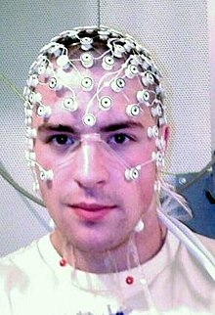

Concept of EEG signal(1/2)
Electroencephalogram (EEG) :
-neurophysiologic measurement of the electrical activity of the brain using electrodes placed on the scalp
-recording of the electrical activity from the scalp
-monitoring human brain activity by electrical mean
Figure 3: EEG signal recording Figure 4: EEG signal analysis

Slide 7
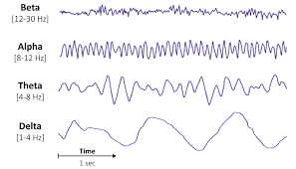
Concept of EEG signal(2/2)
Classification of EEG :
Figure 5 : Different types of normal EEG signal

Slide 8
Filtering
Process of removing unwanted part from the original EEG signal
It provides smooth signal.
Reduces complexity and time
EEG signal consists of a low band frequencies.
This proposed method of EEG signal feature extraction is done by low pass filter which has low band frequency.

Slide 9
Feature extraction(1/4)
Feature represents a distinguishing property from the original signal
Means to minimize loss of important information embedded in the signal
Reducing amount of resources required to describe a large set of data
Accuracy improvements.
Improved Data Visualization.
Increase explain ability of the model.
Reducing data set.
Processing complexity is reduced.

Slide 10
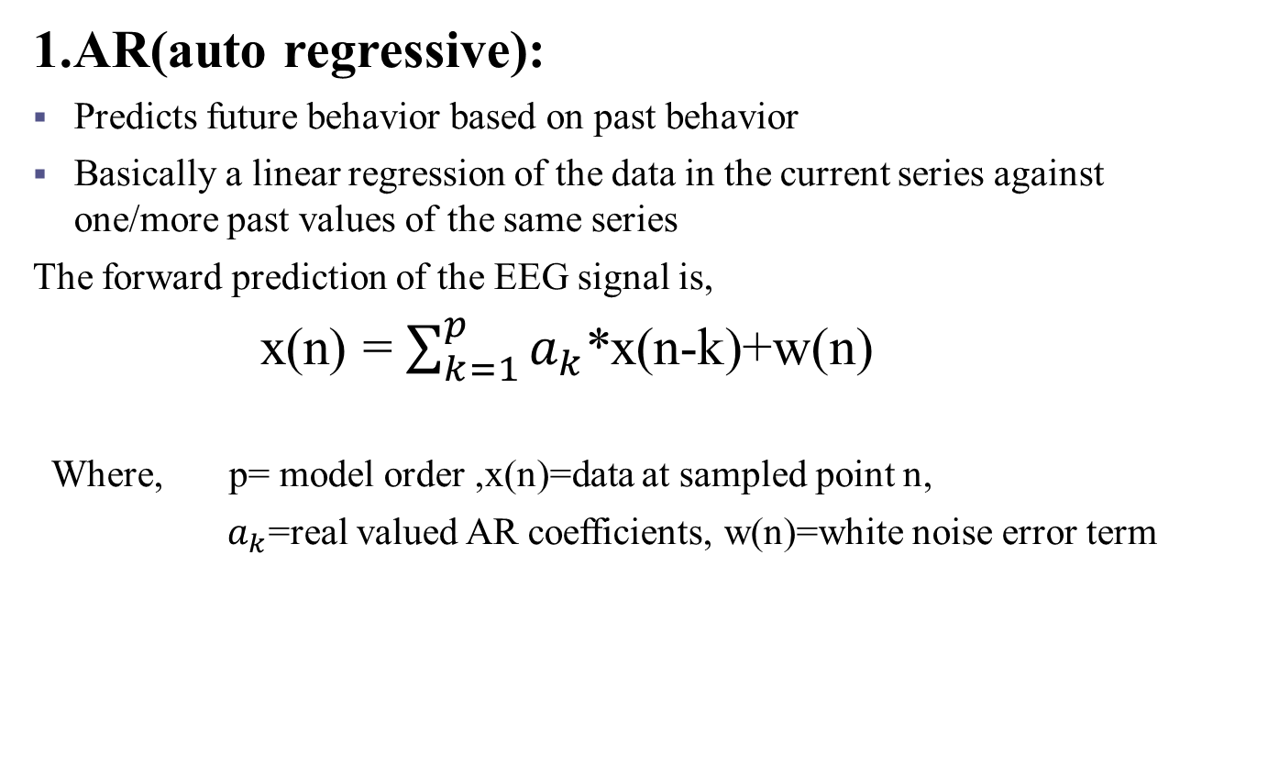
Feature extraction(2/4)
1.AR(auto regressive):
Predicts future behavior based on past behavior
Basically a linear regression of the data in the current series against one/more past values of the same series
The forward prediction of the EEG signal is,
x(n) = $\sum_{k=1}^{p}{a_{k}}$*x(n-k)+w(n)
Where, p= model order ,x(n)=data at sampled point n,
${ a}_{k}$=real valued AR coefficients, w(n)=white noise error term

Slide 11
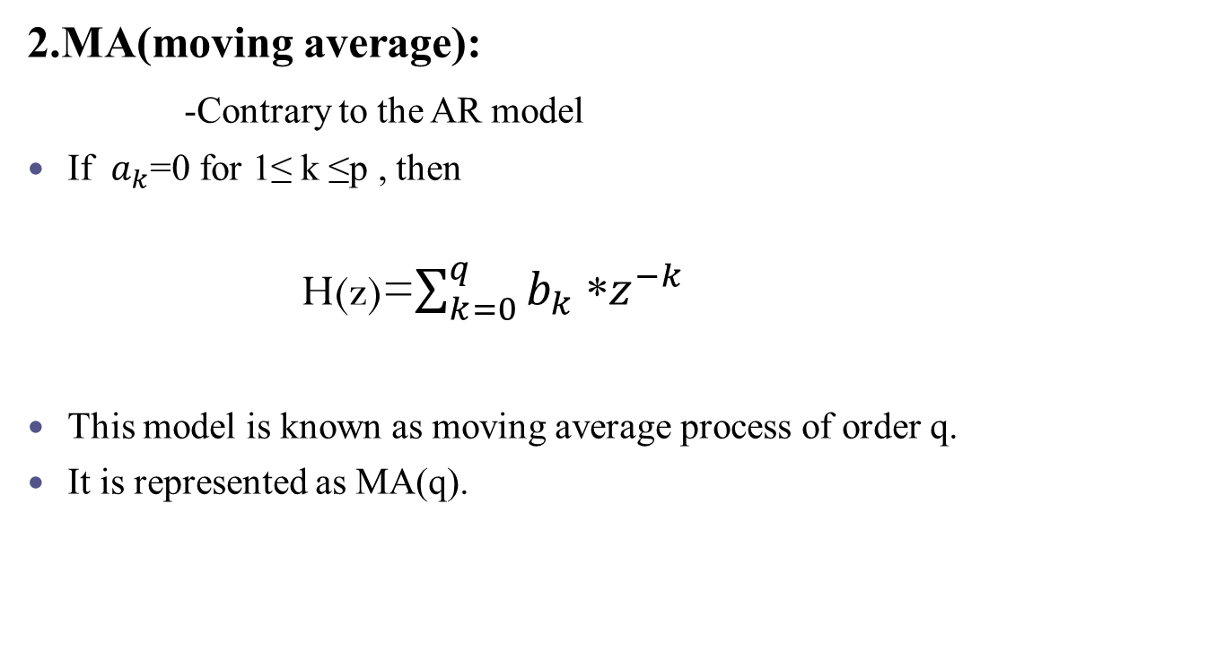
Feature extraction(3/4)
2.MA(moving average):
-Contrary to the AR model
If $a_{k}$=0 for 1≤ k ≤p , then
H(z)=$\sum_{k=0}^{q}{b_{k}}$ *$z^{−k}$
This model is known as moving average process of order q.
It is represented as MA(q).

Slide 12
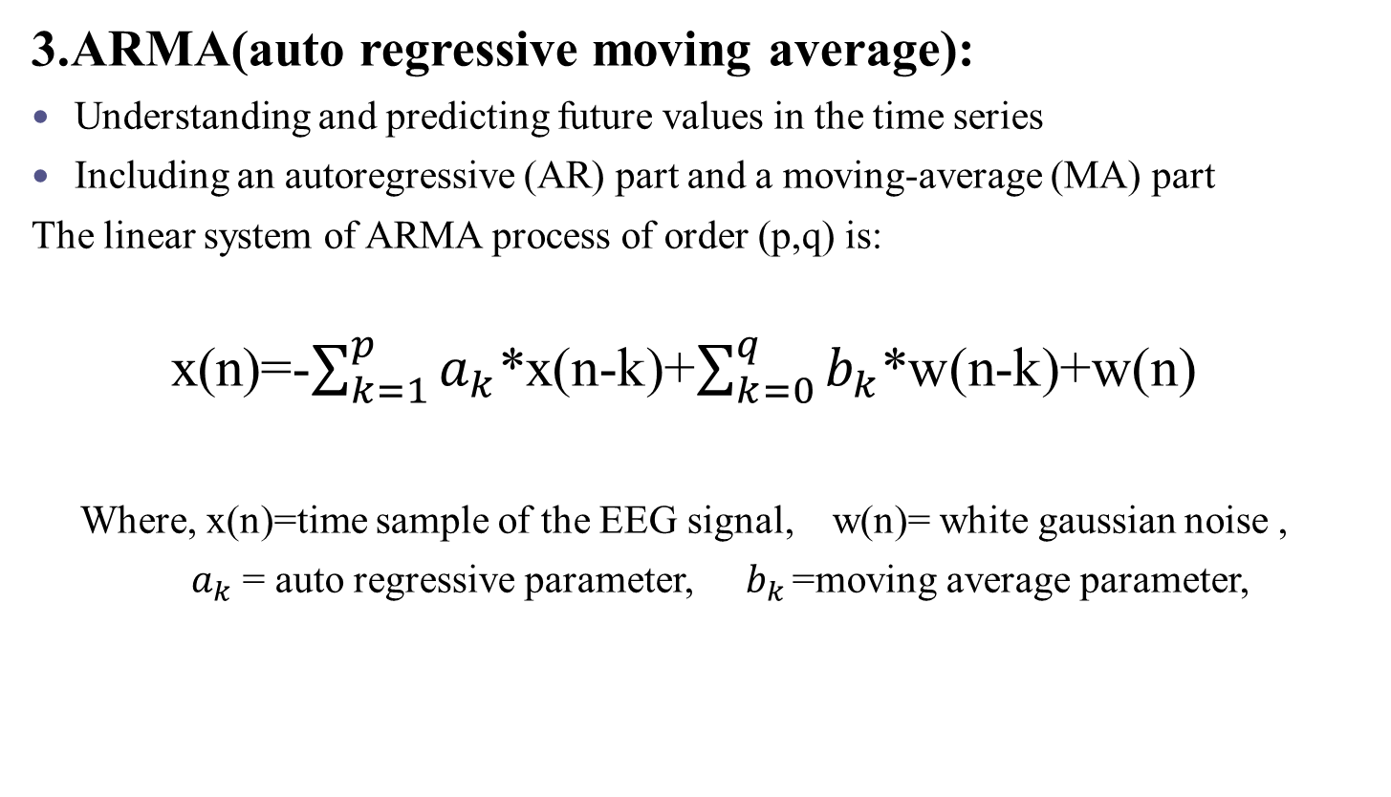
Feature extraction(4/4)
3.ARMA(auto regressive moving average):
Understanding and predicting future values in the time series
Including an autoregressive (AR) part and a moving-average (MA) part
The linear system of ARMA process of order (p,q) is:
x(n)=-$\sum_{k=1}^{p}{a_{k}}$*x(n-k)+$\sum_{k=0}^{q}{b_{k}}$*w(n-k)+w(n)
Where, x(n)=time sample of the EEG signal, w(n)= white gaussian noise ,
$a_{k}$ = auto regressive parameter, ${ b}_{k }$=moving average parameter,

Slide 13
Advantages of AR, MA, ARMA methods for EEG feature extraction
parametric methods provide trustworthy results
provide good results
Contain full information of signal
Provide good performance
Increased accuracy
Visualizes sharp peaks
Generate time-frequency spectra
Provide higher resolution

Slide 14
Vivado Xilinx Software
Vivado Xilinx ISE is a software tool
Produced for synthesis the designs
Perform timing analysis
Examine RTL diagram
Simulate the design
Circuit synthesis
System-level testing
Verilog HDL code:
Use simulation purpose

Slide 15
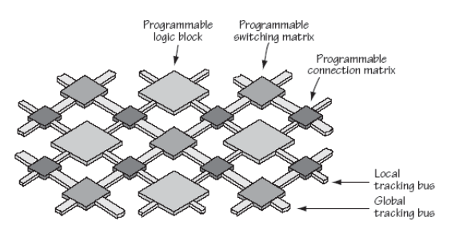
FPGA(Field Programmable Gate Array)
Solution to fill the gap between software and hardware due to its flexibility.
Convert software design to hardware
Figure 6: FPGA internal architecture

Slide 16
Lack of other technology for feature extraction
In machine learning,
It has slow error rate convergence and always easily stuck at the local minima.
Learning speed is slow.
Depends on the experience of the designer.
Depends on CPU time and memory.
In MATLAB,
Required higher computational cost.
Higher complexity.
Analyzing process isn’t an easy method.
requires deep level Matlab knowledge to deal with all errors.

Slide 17
Reasons for using FPGA technology for feature extraction
FPGA creates direct device
This semiconductor technology contain programmable logic blocks and interconnection circuits.
After manufacturing It is programmed or reprogrammed.
It has long-term availability
It has fast and efficient systems
It perform massively parallel data processing
For processing data in parallel way, this technology include a large set of blocks for design purpose.
So scalability of this processor is much greater than other device for data processing.
Other than any software a convenient FPGA board program code is fast running and execute .
It is capable of performing complex tasks.
Reducing data processing the FPGA implementation is easy method

Slide 18
Methodology(1/3)
Input EEG signal
ADC
Filtering
(LPF,HPF)
Feature extraction
(AR,MA,ARMA)
Simulation
(verilog code)
FPGA
(ip chip)

Slide 19
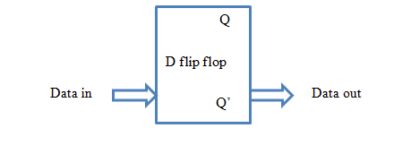
Methodology(2/3)
A. Database:
The input EEG data is collected from BME signal processing lab.
B. Proposed filter design architecture:
Figure7:Block diagram of D flip flop

Slide 20
Methodology(3/3)
The low pass filter equation is , f(i)=mem(i)+mem(i-1) …....(1)
Where , mem(i)=input EEG data , mem (i-1) = one delayed version of input EEG data, f(i) =filtered output EEG data .
In this paper we used noise equation ,n[i]=mem[i]-f[i] ……..(2)
The output of auto regressive model for 3rd order is ,
ar[i]=(a1*f[i-1]+ a2*f[i-2]+ a3*f[i-3])+n[i] …………..(3)
The output of moving average model for 3rd order is ,
ma[i]=b1*n[i-1]+ b2*n[i-2]+ b3*n[i-3] ……………...(4)
The output of auto regressive moving average model for 3rd order is ,
arma[i]=ar[i]+ma[i] ………………………………..(5)

Slide 21
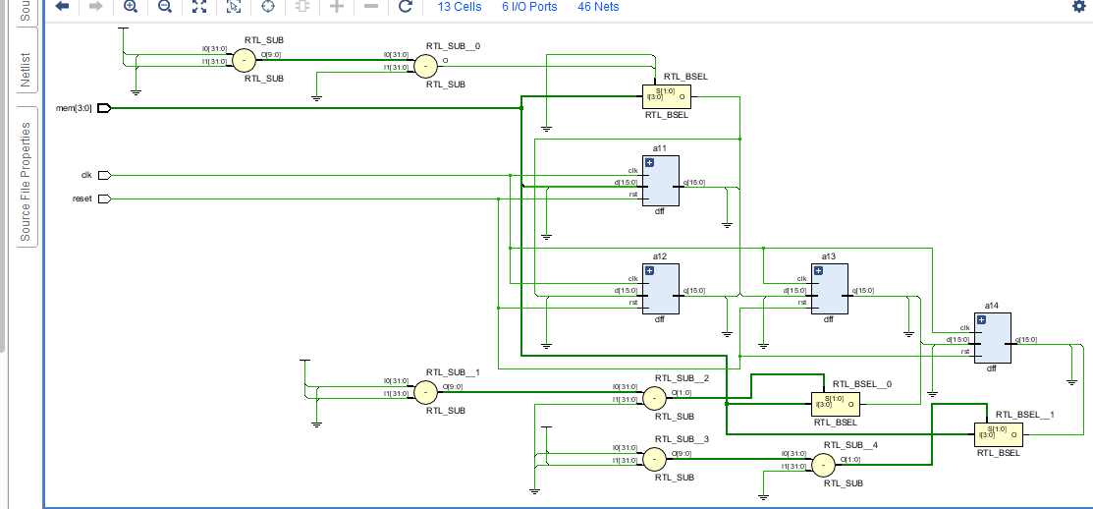
Experimental observation(1/3)
RTL diagram:
Figure 8:RTL diagram of this proposed method

Slide 22
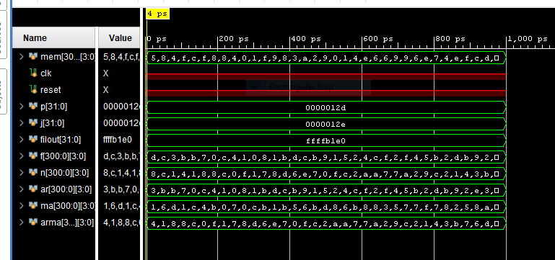
Experimental observation(2/3)
Timing diagram:
Figure 9:Timing diagram of proposed method

Slide 23
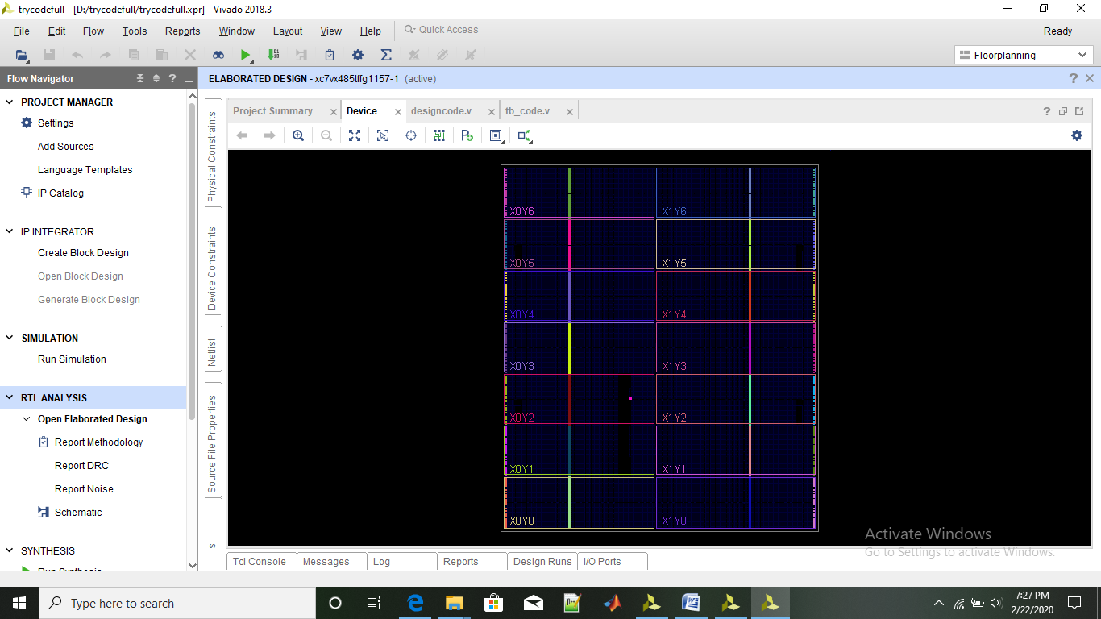
Experimental observation(3/3)
Input /Output pin layout:
Figure10:Pin layout of proposed method

Slide 24
Result Analysis(1/10)
Sl.No | EEG(mem) | Filter_output(f)
1 | 5 | d
2 | 8 | c
3 | 4 | 3
4 | f | b
5 | c | b
6 | f | 7
7 | 8 | 0
8 | 8 | c
9 | 4 | 4
10 | 0 | 1
11 | 1 | 0
12 | f | 8
13 | 9 | 1
14 | 8 | b
15 | 3 | d
16 | a | c
17 | 2 | b
18 | 9 | 9
19 | 0 | 1
20 | 1 | 5

Slide 25
Result Analysis (2/10)
Sl.No | EEG(mem) | Filter_output(f) | Noise(n) | AR | MA | ARMA
1 | 5 | d | 8 | c | 1 | 4
2 | 8 | c | c | b | 6 | 1
3 | 4 | 3 | 1 | b | d | 8
4 | f | b | 4 | 7 | 1 | 8
5 | c | b | 1 | 0 | c | c
6 | f | 7 | 8 | c | 4 | 0
7 | 8 | 0 | 8 | 4 | b | f
8 | 8 | c | c | 1 | 0 | 1
9 | 4 | 4 | 0 | 0 | 7 | 7
10 | 0 | 1 | f | 8 | 0 | 8
11 | 1 | 0 | 1 | 1 | c | d
12 | f | 8 | 7 | b | b | 6
13 | 9 | 1 | 8 | d | 1 | e
14 | 8 | b | d | c | b | 7
15 | 3 | d | 6 | b | 5 | 0
16 | a | c | e | 9 | 6 | f
17 | 2 | b | 7 | 1 | b | c
18 | 9 | 9 | 0 | 5 | d | 2
19 | 0 | 1 | 8 | 2 | 8 | a
20 | 1 | 5 | c | 4 | 6 | a

Slide 26
Result Analysis (3/10)
Sl.No | EEG(mem) | Feature value
1 | 5 | f
2 | 8 | 3
3 | 4 | 5
4 | f | 8
5 | c | 6
6 | f | 9
7 | 8 | 5
8 | 8 | 6
9 | 4 | f
10 | 0 | 1
11 | 1 | c
12 | f | 8
13 | 9 | d
14 | 8 | b
15 | 3 | f
16 | a | d
17 | 2 | 0
18 | 9 | 8
19 | 0 | b
20 | 1 | e

Slide 27
Result Analysis (4/10)
Different band identification of EEG signal
EEG signal | F_electrod | N_electrod | O_electrod
Alpha | Exist | Exist | Exist
Beta |  | Exist
Gamma |  |  | Exist
Theta
Delta

Slide 28
Result Analysis (5/10)
Figure 11:Comparison between input EEG data and filtered data in Excel

Slide 29
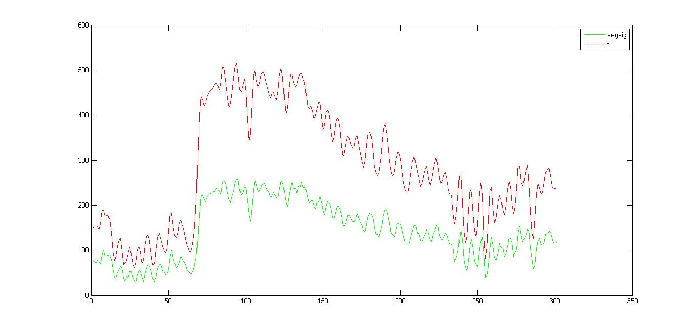
Result Analysis (6/10)
Figure 12:Comparison between input EEG data and filtered data in Matlab

Slide 30
Result Analysis (7/10)
Figure13: Comparison between input EEG data and noise in Excel

Slide 31
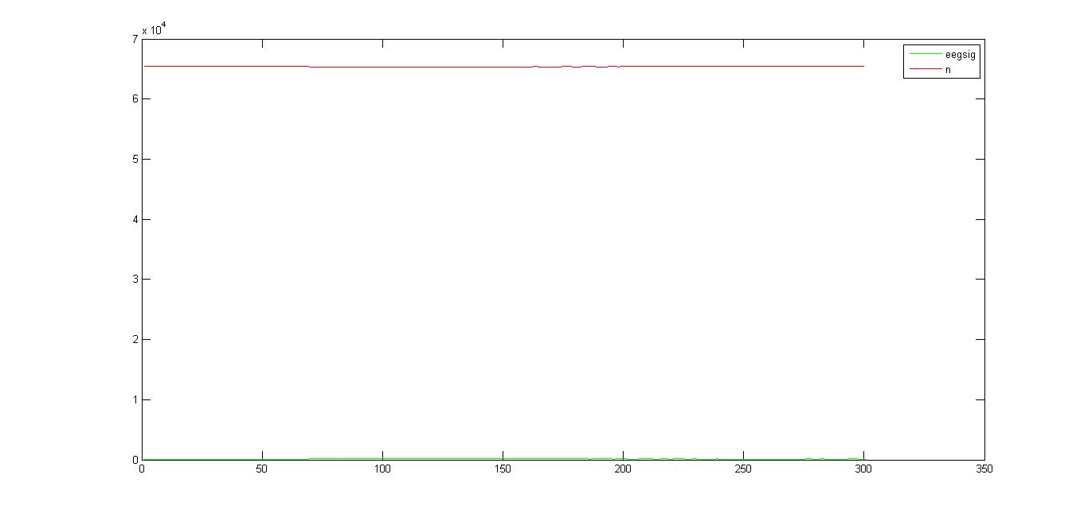
Result Analysis (8/10)
Figure14: Comparison between input EEG data and noise in Matlab

Slide 32
Result Analysis (9/10)
Figure15: Feature value in AR,MA,ARMA method on Excel

Slide 33
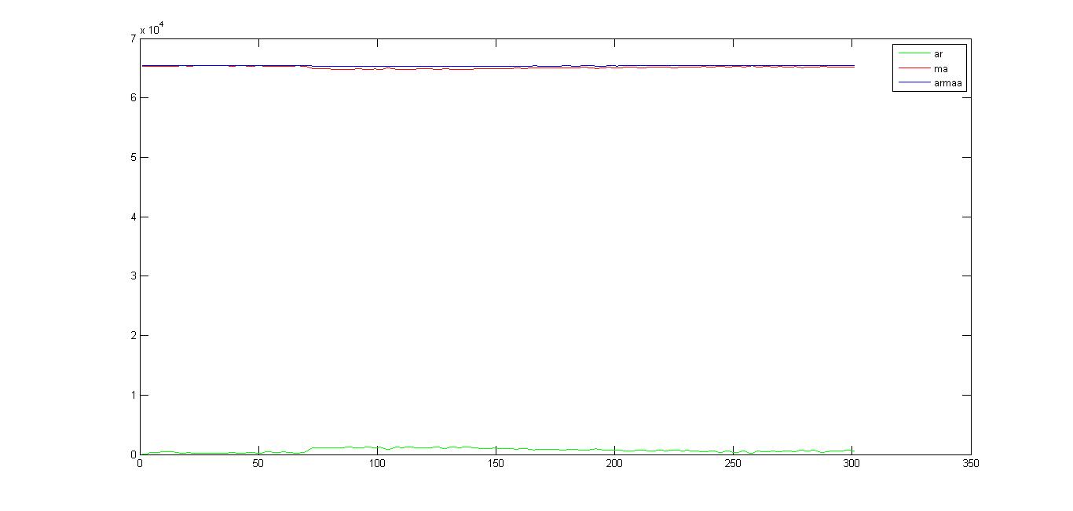
Result Analysis (10/10)
Figure16: Feature value in AR,MA,ARMA method on Matlab

Slide 34
Conclusion
Easy and simple approach
Parametric method (AR,MA,ARMA) is applied for describing ,feature extracting the signal
-estimated by simple algorithms
-short-term spectrum can be distinguished
- sensible accuracy
-applied in time series analysis
Feature value and EEG classification is determined
filter output performs de-noising without causing distortion
These feature extraction procedure will help us to determine classification of EEG signal
Using Verilog code of Vivado Xilinx ISE software , this proposed biochip will be designed

Slide 35
Future work
For purpose of future analysis,
To increase system efficiency filter algorithm can be modified.
Using up-sampling and down-sampling for accurate filtering.
The design system can be extended using other technology.
The design system can be extended using other bio-signal analysis.
The design system can be extended for bio-signal classification.
The total system designed in software can be integrated in the format of chip using FPGA. That is software implementation can be converted to hardware implementation using FPGA that can be used in practical implementation of EEG signal analysis.

Slide 36
References
[1] N.Tabassum , S. M.R Islam, “Implementation of Biochip on Multirate System for EEG signal on ALTERA Cyclone Device”, 3rd International Conference on Electrical Information and Communication Technology (EICT), 7-9 December 2017, Khulna, Bangladesh
[2] A.G.Reddy, S. Narava, “Artifact Removal from EEG Signals”, International journal of computer application(0975-8887),volume 77-No.13, September 2013.
[3] H. K.Sawant and Z. Jalali, “Detection and classification of EEG waves”, Orient Journal of Computer Science & Technology, vol.3(1), 207-213 (June 4, 2010).
[4] A. Procházka and J. Kukal, O. Vyšata, “Wavelet Transform Use for Feature Extraction and EEG Signal Segments Classification”, Conference: Conference: Communications, Control and Signal Processing, 2008. ISCCSP 2008.
[5] Hannu Olkkonen, “Discrete Wavelet Transform-Biomedical Applications”, ISBN 978-953-307-654-6, publisher: InTech, Chapter published September 12,2011.
[6] P. M. Wai, Y. Zheng, Z, Zhao, “A 0.18-μm CMOS Multirate Filter Bank ASIC for Biomedical Applications ”, 2007 IEEE International Symposium on Integrated Circuits(ISIC 2007).
[7] C. Chou, S. Mohanakrishnan, and J. B. Evans, “FPGA Implementation of Digital Filters”, Proc. Int. Conf. Signal Proc. Appl. & Tech. (ICSPAT’93),1993.

Slide 37


